Slide 1


Cairo University
Faculty of Computers and Information
CS251 – Software Engineering
Lecture 2: OOP Overview
Slides by
Mohammad El-Ramly, PhD
2015
http://www.acadox.com/join/75UDWT

Slide 2
Lecture Objectives
Learn the Characteristics of Object-Orientation
  Identity
  Classification
  Abstraction
  Encapsulation
  Aggregation
  Inheritance
  Polymorphism
  Genercity
Learn the OO Development Methodology
  Steps of OOP Development
Examples of OO Modeling
6-<number>

Slide 3
Previous Lecture
Definition of Software Engineering
Software Body of Knowledge
  Software Requirements
  Software Design
  Software Construction
  Software Testing
  Software Maintenance
  Software Configuration Management
  Software Engineering Management
  Software Engineering Process
  Software Engineering Tools and Methods
  Software Quality
  Software Engineering Professional Practice
  Software Engineering Economics

Slide 4
أنت لا تعيش لكي تتنفس ، بدون التنفس ستموت طبعا ،
لكن التنفس ليس هدفك!
وأنت لا تعيش لأجل جمع المال ،
بدون المال يتكون حياتك صعبة طبعا،
لكن جمع المال ليس هدفك !
إذا ما هو هدفك ؟!

Slide 5
What is OO ?
Object-orientation is a way of thinking about problems using models built from real-world concepts.
The fundamental unit is the Object
An object has data and behavior
OO Software means we write our program in terms of objects, each tightly integrates data and operations on the data
In Structured programming, data and operations on the data were separated or loosely related.

Slide 6
I. OO Characteristics
Identity
Classification
Abstraction
Aggregation
Encapsulation
Inheritance
Polymorphism
Genercity

Slide 7
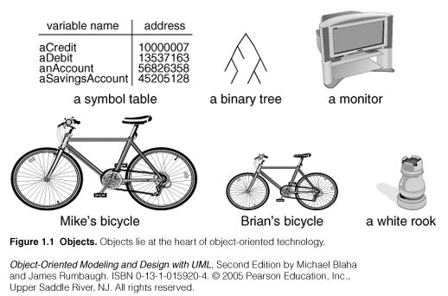
1.1 Identity

Slide 8

Identity
Identity means that data is quantized in into discrete, distinguishable, entities called objects
An object can be concrete like a car, a file, …
An object can be conceptual like a feeling, a plan,…
Each object has its own identity even if two objects have exactly the same attributes. They are still different separate objects.
Ali’s car
Khaled’s car

Slide 9
Identity
Object identity is the property by which each object can be identified and treated as a distinct software entity
Each object has something unique which distinguishes it from all its fellow objects. It is its memory address (or handle) that is referred to by one or more object identifiers (OID)
Car myCar(“Opel”, 2005);
The object handle is 0x00FDA610
is referenced by an object
identifier myCar
model: Opel
year: 1994
myCar:0x00FDA610

Slide 10


Slide 11
1.2 Classification
Classification means that objects with the same data structure (attributes) and behavior (operations) belong to the same class
A class is an abstraction that describes the properties important for a specific application
The choice of classes is arbitrary and application-dependent.
3
2
Mina’s car
Ali’s car
Samir’s car
A Car

Slide 12
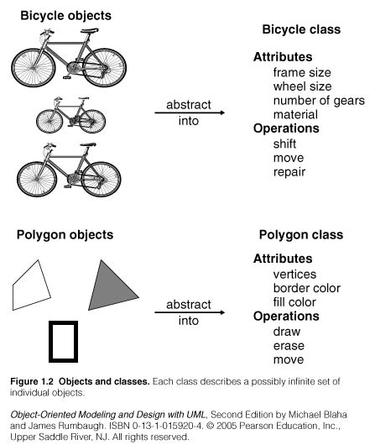
Classification
Each object is an instance of a class
Each object has a reference to its class (knows which class it belongs to)

Slide 13
1.3 Abstraction
Abstraction is the selective examination of certain aspects of a problem.
Abstraction aims to isolate the aspects that are important for some purpose and suppress the unimportant aspects.
The purpose of abstraction determines what is important and what is not.

Slide 14
Abstraction
All abstractions are incomplete and inaccurate.
In modeling, do not search for the truth but for adequacy for some purpose.
There is no single correct model for a problem. Only adequate and inadequate ones.
A good model captures the crucial aspects of a problem and omits the rest.
A class abstracts a real concept according to the needs of a specific application.

Slide 15
Abstraction
Different abstractions for the concept of a car according to the application.
Car
motorCapacity: int
model: string
make: string
year: int
licenseNumber: string
+Car (int, ….): void
+getMake (): string
+printDetails(): void
+ . . . . . . . .
Car
model: string
licenseNumber: string
problem: string
owner: string
balance: float
isFinished: bool
+Car (string,...): void
+printBlanace (): string
+printDetails(): void
+ . . . . . . . .
فى معرض السيارات
At Car Dealer
Car
model: string
make: string
year: int
salePrice: int
paymentMethod: int
+Car (string,...): void
+sell (Customer): void
+ . . . . . . . .
+ . . . . . . . .
فى المرور
At Traffic Dept
فى الورشة
At Repair Shop

Slide 17
1.4 Encapsulation
Encapsulation separates the external aspects of an object, that are accessible to other objects, from the internal implementation details that are hidden from other objects.
Encapsulation reduces interdependency between different parts of the program.
You can change the implementation of a class (to enhance performance, fix bugs, etc.) without affecting the applications that use objects of this class.

Slide 18
Encapsulation
It allows you to replace an algorithm with a faster one while keeping the class interface (public methods) the same.
void sort () { // Bubble Sort
int i, j;
for (i = length - 1; i > 0; i-) {
for (j = 0; j < i; j++) {
if (items [j] > items [j + 1]) {
int temp = items [j];
items [j] = items [j + 1];
items [j + 1] = temp;
}
}
}
}`
List
items: int [ ]
length: int
+ List (array): void
+ search (int): bool
+ getMax (): int
+ sort(): void
void sort () { // Quick Sort
……….
}`

Slide 19
It allows you to replace a data item with another one while keeping the class interface (public methods) the same.
Encapsulation
List
items: int [ ]
length: int
+ List (array): void
+ search (int): bool
+ getMax (): int
+ sort(): void
List
items: vector<int>
+ List (array): void
+ search (int): bool
+ getMax (): int
+ sort(): void
void sort () { // Bubble Sort
int i, j;
for (i = items.size()- 1; i > 0; i-) {
for (j = 0; j < i; j++) {
if (items [j] > items [j + 1]) {
swap (items [j], items [j + 1]);
}
}
}
}

Slide 20
Encapsulation
Data hiding. Information from within the object cannot be seen outside the object.
Implementation hiding. implementation details within the object cannot be seen from the outside.

Slide 22
1.5 Aggregation
Aggregation is the ability to create new classes out of existing classes
  Treating them as building blocks or components
Aggregation allows reuse of existing code
Aggregation describes a “has a” relationship. One object is a part of another object.
A car has wheels.

Slide 23
Aggregation
Two forms of aggregation
  Whole-Part relationships
    Car is made of Engine, Chassis, Wheels
    composite aggregation (the composite “owns” the part)
  Containment relationships
    A Shopping Cart contains several Products
    A List contains several Items
    shared aggregation (the part is shared by more than one composite).

Slide 25
1.6 Inheritance
Inheritance is the sharing of features (attributes and operations) among classes based on a hierarchical relationship.
A superclass (also parent or base ) has general features that sublcasses (child or derived ) refine and elaborate.
Each subclass inherits all the features of its superclass.
Inheritance is one of the strongest features of OO technology.

Slide 26
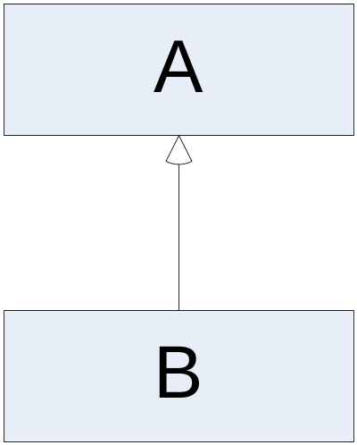
Inheritance
Inheritance is the facility by which objects of a class (say B) may use the methods and variables that are defined only to objects of another class (say A), as if these methods and variables have been defined in class B
Inheritance is represented as
shown in UML notation.

Slide 27
How to use Inheritance?
Inheritance helps building software incrementally:
First; build classes to cope with the most straightforward (or general) case,
Second; build the special cases that inherit from the general base class. These new classes will have the same features of the base class plus their own.
Car
motorCapacity: int
model: string
make: string
year: int
+Car (int, ….): void
+getMake (): string
+printDetails(): void
+ . . . . . . . .
FourWheelCar
Truck

Slide 29
1.7 Polymorphism
Polymorphism means that the same operation may behave differently for different classes.
An operation is a procedure or a transformation that the object performs or is subject to.
An implementation of an operation by a specific class is called a method.
Because an OO operation is polymorphic, it may have more than one method for implementing it, each for a different class.

Slide 30
Polymorphism
Shape
color: int
+ Shape (int): void
+ getColor (): int
+ setColor (int): void
+ getArea(): float
Italic means operation is specified but not implemented in the base class
Rectangle
length: float
width: float
+ Rectangle …….
+ getArea(): float
Circle
radius: float
+ Circle(int, int): void
+ getRadius(): float
+ setRadius(): float
+ getArea(): float
Square
side: float
+ Square(int, int): void
+ getSide(): float
+ setSide(): float
+ getArea(): float
length x width
side²
Π x radius²

Slide 31
Inheritance, polymorphism and aggregation ?
BankAccount
int acctNum
Client acctHolder
double balance
SavingsAccount
double interestRate
double accruedInterest
Time lastBalanceChange
BankAccount(Client info)
void deposit(double amt)
boolean withdraw(double amt)
void printStatement()
SavingsAccount(...)
void updateIntRate(double rate)
void deposit(double amt)
boolean withdraw(double amt)
ChequingAccount
double minBalance
ChequingAccount(…)
boolean withdraw(double amt)
double calcServiceFee()

Slide 32
1.8 Genericity
Genericity is the construction of class A so that one or more of the classes it uses internally is supplied only at run-time (at the time that an object of class A is instantiated)
This means that the class is parameterized, i.e., the class gets a parameter which is the name of another type.
T will be known at runtime
Sorter
data [ ]: T
+ sortData (): void
+ …….

Slide 34
II. OO Development Methodology
Why building models?
To test the system before building it
To communicate with the customer
To visualize your ideas
To reduce complexity

Slide 35
OO Development Stages
System conception
Analysis
System design
Class design
Implementation
Testing
Training
Deployment
Maintenance
There is a need or idea
What will / will not be done
Overall architecture
Detailed design
Programs
Make sure it works well
Train the end user to use it
Install it
Fix bugs & add functions to stay relevant
http://www.computerweekly.com/news/2240105488/Olympic-software-engineers-enter-final-leg-of-marathon-IT-development-project

Slide 36
Class Model
A class model captures the static structure of the system by characterizing
  the objects in the system,
  the relationships among the objects and
  the attributes and operations for each class of objects
Class model is the most important UML model
UML is Unified Modeling Language for OO systems

Slide 37
Object and Class Concepts Objects
The class model describes the system’s objects
Objects often appear as proper nouns in the problem description or discussion with the customer.
Some object correspond to real world entities (Dr El-Ramly, Oxford University, the old turtle in the zoo)
Some objects correspond to conceptual entities (the formula for solving an equation, operand checker, etc.)
The choice of objects depends on the analyst’s judgment and the problem in hand. There can be more than one correct representation.

Slide 38
Objects
Objects have identities and are distinguishable from each other
Each object has a memory address that is referred to by one or more object identifiers (OID)
و كمان تفاحة
كمان تفاحة
تفاحة

Slide 39
Class
An object is an instance of or occurrence of a class
A class describes a group of objects with the same
  Properties (attributes)
  Behavior (operations)
  Kinds of relationships and
  Semantics
Person, Company and Window are all classes
Classes often appear as common nouns and noun phrases in problem description and discussion with customers or users

Slide 40

Class
Objects in a class share a common semantic purpose in the system model
Both car and cow have price and age
If both were modeled as pure financial assets, they both can belong to the same class.
If the application needs to consider that:
  Cow eats and produces milk
  Car has speed, make, manufacturer, etc.
Then model them using separate classes.
So the semantics depends on the application

Slide 41
Class
Financial Asset
type: int
age: float
currentValue: float
. . .
. . .
+getCurrentValue: int
+printDetails(): void
+ . . . . . . . .
Cow
wight: float
age: string
spices : string
owner: string
gender: char
isPregnant: bool
+Cow (string,...): void
+getOwner (): string
+printDetails(): void
+ . . . . . . . .
فى معرض
السيارات
Car at Dealer
Car
model: string
make: string
year: int
maxSpeed: int
paymentMethod: int
+Car (string,...): void
+sell (Customer): void
+ . . . . . . . .
+ . . . . . . . .
البقرة و السيارة فى نفس الكلاس
Cow & Car Same Class
فى المزرعة
Cow in Farm

Slide 42
Problem Domain
Problem domain is the set of objects, events and relations that define the environment of the problem.
It is very very important to understand the problem domain before solving the problem.
If needed get a domain expert.
An important task in OOP is identifying the classes that will represent the problem domain
This is not required for all classes but for the classes related to the problem solution.

Slide 44
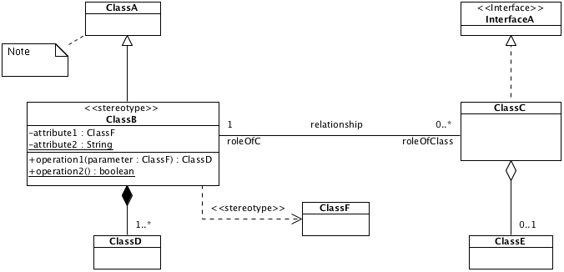
UML Class Diagram Summary
UML is the dominant OO modeling language today.

Slide 45
UML Class Diagram Links
http://www.idt.mdh.se/kurser/cd5490/2004/lectures/UML%20Intro.pdf
http://www.step-10.com/SoftwareDesign/UML/UMLClassDiagramsASummaryOfTheBasics.html
http://www.ibm.com/developerworks/rational/library/content/RationalEdge/sep04/bell/

Slide 47
III. Examples
Example 1: Car Service Quotes
Ali’s Mechanic Shop services expensive cars like Mercedes and BMW. When a customer brings a car to the shop, the manager gets the customer’s name, address and phone number. Then the manager fills the car make, model and year. After inspection, the manager gives the customer a service quote. The quote shows the estimated parts charges, estimated labor charges and the total estimated charges.

Slide 48
Example 1: Car Service Quotes
Read the problem description very carefully
Identify all the nouns in the problem description
Refine the noun list
  Remove nouns that represent the same concept
  Remove nouns that represent concepts irrelevant to the problem solution
  Remove nouns that represent objects or instances of classes
  Remove nouns that can be data fields in classes represented by primitive data types
Identify the responsibilities of each class

Slide 49
Example 1: Car Service Quotes
Ali’s Mechanic Shop services expensive cars like Mercedes and BMW. When a customer brings a car to the shop, the manager gets the customer’s name, address and phone number. Then the manager fills the car make, model and year. After inspecting the car, the manager gives the customer a service quote. The quote shows the estimated parts charges, estimated labor charges and the total estimated charges.

Slide 50
Example 1: Car Service Quotes
Ali’s Mechanic Shop services expensive cars like Mercedes and BMW. When a customer brings a car to the shop, the manager gets the customer’s name, address and phone number. Then the manager fills the car make, model and year. After inspecting the car, the manager gives the customer a service quote. The quote shows the estimated parts charges, estimated labor charges and the total estimated charges.

Slide 51
Example 1: Car Service Quotes
Ali’s Mechanic Shop services expensive cars like Mercedes and BMW. When a customer brings a car to the shop, the manager gets the customer’s name, address and phone number. Then the manager fills the car make, model and year. After inspecting the car, the manager gives the customer a service quote. The quote shows the estimated parts charges, estimated labor charges and the total estimated charges.

Slide 52
Example 1: Car Service Quotes
Ali’s Mechanic Shop services expensive cars like Mercedes and BMW. When a customer brings a car to the shop, the manager gets the customer’s name, address and phone number. Then the manager fills the car make, model and year. After inspecting the car, the manager gives the customer a service quote. The quote shows the estimated parts charges, estimated labor charges and the total estimated charges.

Slide 53
Example 1: Car Service Quotes
Ali’s Mechanic Shop services expensive cars like Mercedes and BMW. When a customer brings a car to the shop, the manager gets the customer’s name, address and phone number. Then the manager fills the car make, model and year. After inspecting the car, the manager gives the customer a service quote. The quote shows the estimated parts charges, estimated labor charges and the total estimated charges.

Slide 54
Example 1: Car Service Quotes
Car
name : String
model : String
year : int
Customer
+ Car ()
+ setMake (m: String): void
. . . .
name : String
address : String
phone : String
+ Customer ()
+ setName (n: String): void
. . . .

Slide 55
Example 1: Car Service Quotes
ServiceQuote
partsCharge : double
laborCharges : double
+ ServiceQuote ()
+ setPartsCharges (c: double): void
. . . .

Slide 58
Lecture Objectives
Learn the Characteristics of Object-Orientation
  Identity
  Classification
  Abstraction
  Encapsulation
  Aggregation
  Inheritance
  Polymorphism
  Genercity
Learn the OO Development Methodology
  Steps of OOP Development
Examples of OO Modeling
6-<number>

Slide 59
Pearls of Wisdom
Singapore has only people
Skills is what you should get out of here not degree
  Loving and caring about others
  Sharing knowledge with others
  Teamwork and cooperation
  Self-discipline
  Self-learning and self-motivation
  Research skills
  Computer and IT stuff

Slide 60
Next Lecture
Chronic Software Crisis
Arian 5
Therac 25
London Ambulance System
Vasa
6-<number>

Slide 61
To Learn OOP
Read, Watch and Solve
Review OOP videos and slides
Reading 1 – OOP in Java
  7.1 to 7.8 && 7.12 to 7.16

Slide 62
For Next Time
Read, Watch and Solve
Watch Software Crisis videos
Reading 2 – Ariane 5
Reading 3 – London Ambulance System
1nline till 23 Oct.

Slide 63
كيف تنجح فى هذا الكورس
جدد النية و استعن بالله و لا تعجز
نظم وقتك و خصص وقت و مكان مناسبين للدراسة وفق جدول ثابت يناسب ظروفك
شاهد فيديوهات المحاضرات و ذاكر للمحاضرة قبل أن تأتى
شارك فى تمارين المحاضرة و استفد من زملائك
اعمل تمارين المعمل سواءا فى الكلية أو البيت
شارك بقوة فى مشروع المقرر
كن مستعدا للتغيير و تبني عقلية النجاح.
  التغيير يحتاج لممارسة العادة الجديدة 30 يوماً

Slide 64
كن مستعدا للتغيير و تبني عقلية النجاح .......
التغيير الأول
  نام بكير فيق بكير شوف الصحة كيف بتصير
  بورك لأمتى فى بكورها
  فوائد النوم المبكر
    GPA أعلى بدرجة كاملة
    أكثر إيجابية
    أكثر قدرة على مواجهة المشاكل
    أكثر تفاؤلا
    نوم أعمق و أفضل
http://www.forbes.com/pictures/gglg45gfd/benefits-of-early-risers/

Slide 65
كن مستعدا للتغيير و تبني عقلية النجاح .......
التغيير الثانى
  موعد مع الله
  تخيل الرئيس أو الملك يقابلك كل يوم صباحا يعطيك عهده و أمانه و يسمع طلباتك.
  قال رسول الله ص: من صلى الصبح فهو في ذمة الله ، فلا يطلبنكم الله من ذمته بشيء, فيدركه, فيكبه في نار جهنم.

